Slide 1




Using Dev Containers to Test your Scripts
Rob Sewell
He/Him
Beard Twizzler
Sewells Consulting Ltd

Slide 2


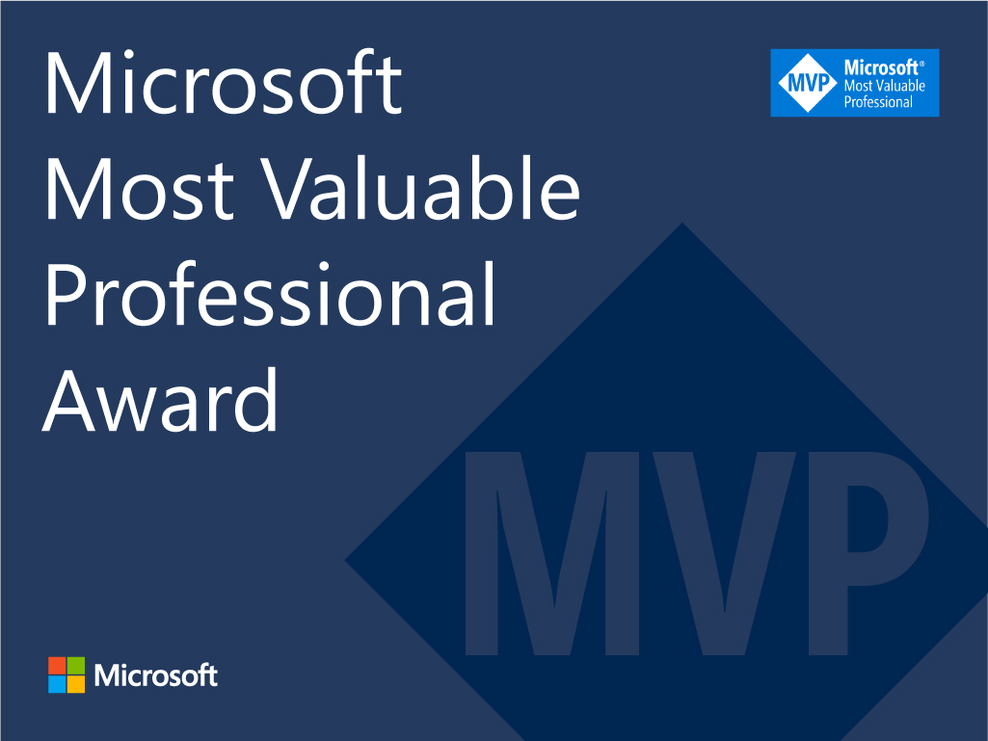





Rob
Sewell
He/Him
Bearded Consultant
Sewells Consulting Ltd
@sqldbawithbeard
blog.robsewell.com
github.com/SQLDbaWithABeard
linkedin.com/in/robsewellsqldba

Slide 3
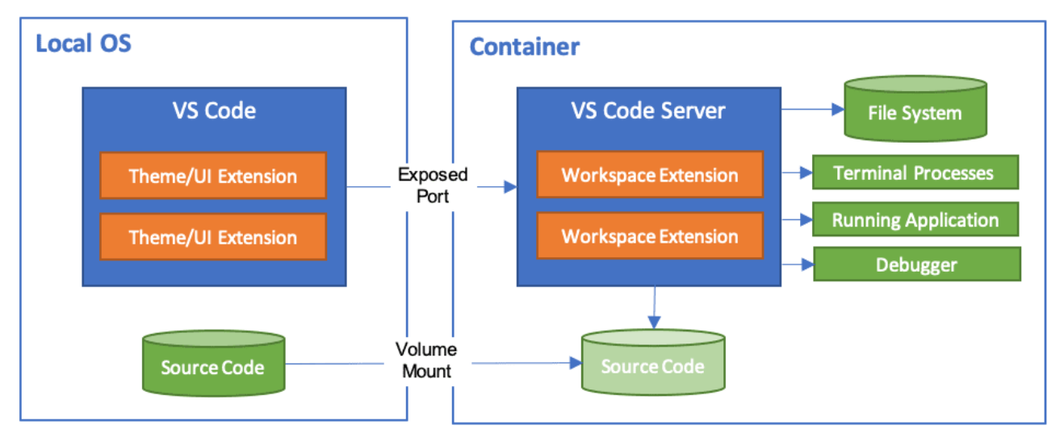

Dev Container
code.visualstudio.com/docs/remote/containers
Notes:
Jess
Run VSCode locally and connect to
a docker container as a remote server
Setup the environment as code – then it can be used by anyone
Include vs extensions
Mount source code folder into container
Can install things inside the container that you need – and not have to install on your desktop
We have options for how we setup dev container
Could use ‘post create command’ in devcontainer.json
Or could bake it into the container image and build the devcontainer from that image

Slide 4
Dev Container
code.visualstudio.com/docs/remote/containers
Notes:
Jess
Run VSCode locally and connect to
a docker container as a remote server
Setup the environment as code – then it can be used by anyone
Include vs extensions
Configuration as code
Mount source code folder into container
Can install things inside the container that you need – and not have to install on your desktop
We have options for how we setup dev container
Could use ‘post create command’ in devcontainer.json
Or could bake it into the container image and build the devcontainer from that image

Slide 5
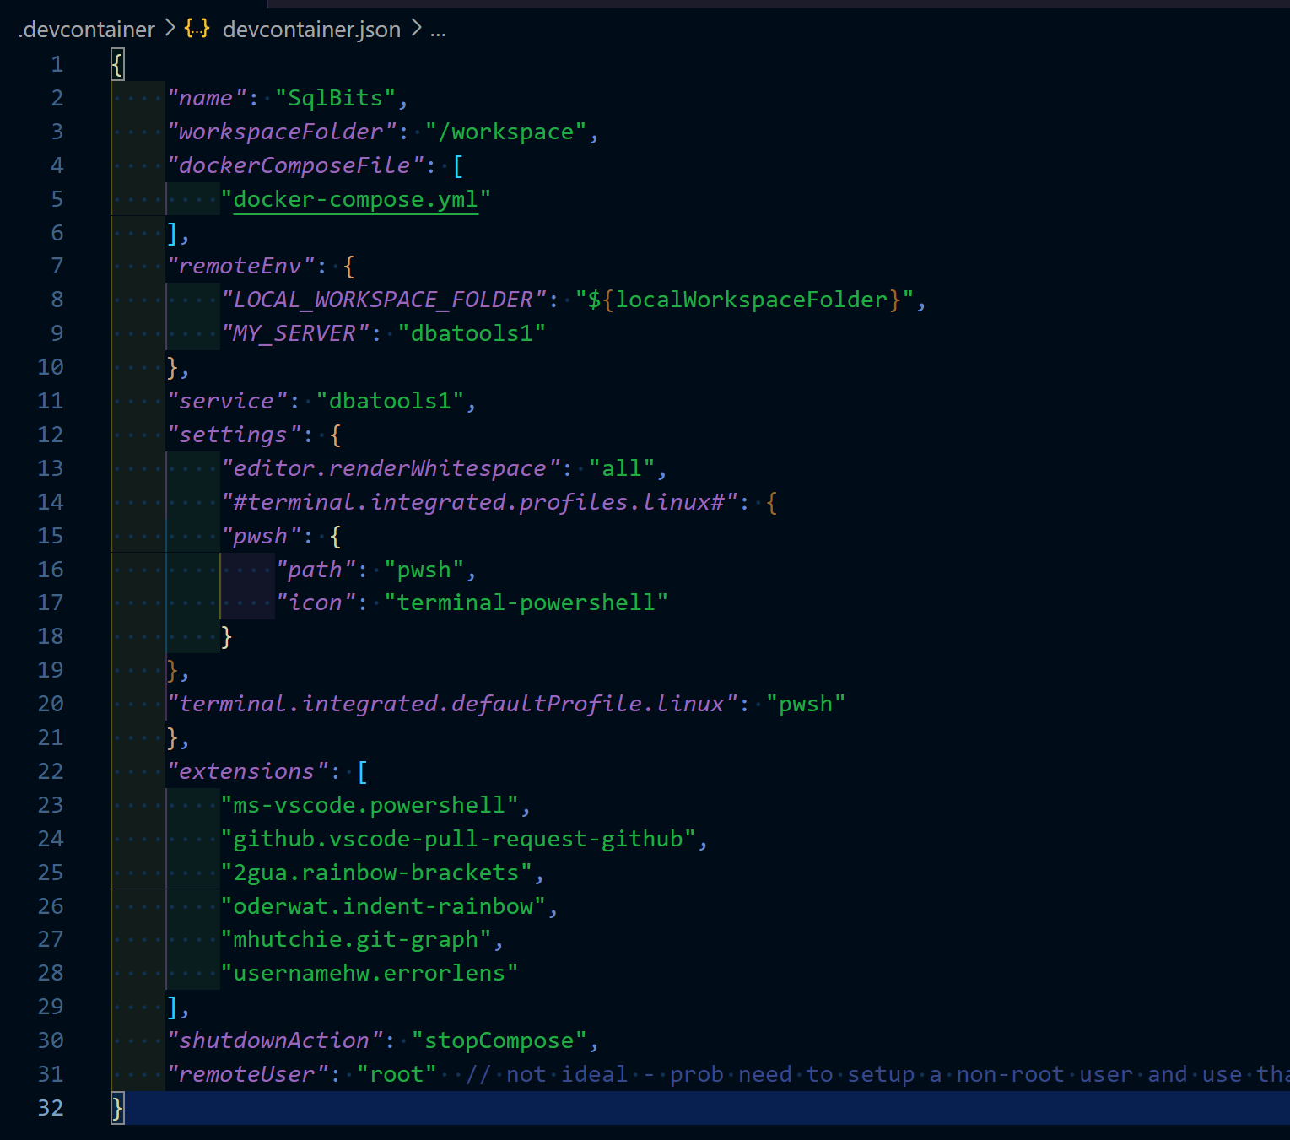
devcontainer.json
Notes:
Jess
Just add a devcontainer.json and set it up how you want your environment to be
Anybody that opens the repo in VsCode – it’ll see this devcontainer.json file and prompt you to open in container – we’ll point that out in the demo
Workspace folder – where it’ll end up
Service – is where we want to go - ‘the service you want to work on’
Extensions –

Slide 6
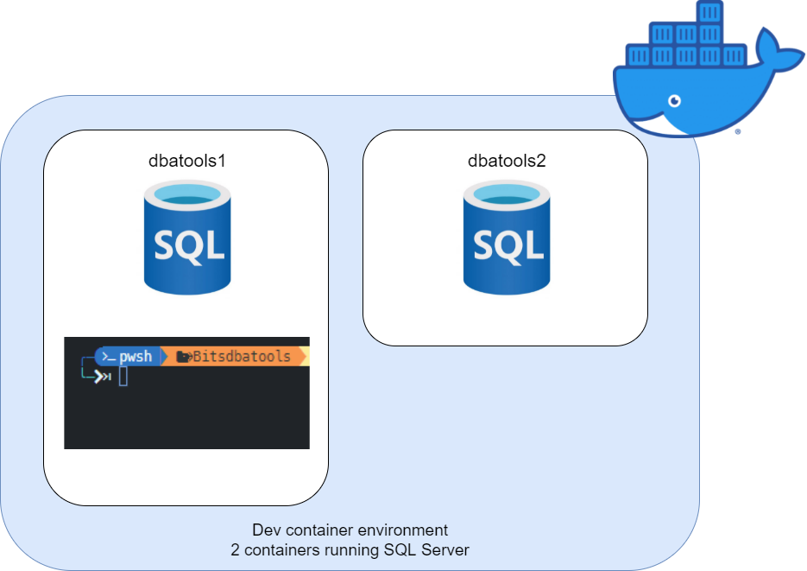
Notes:
Rob describe the entry point and the env

Slide 7
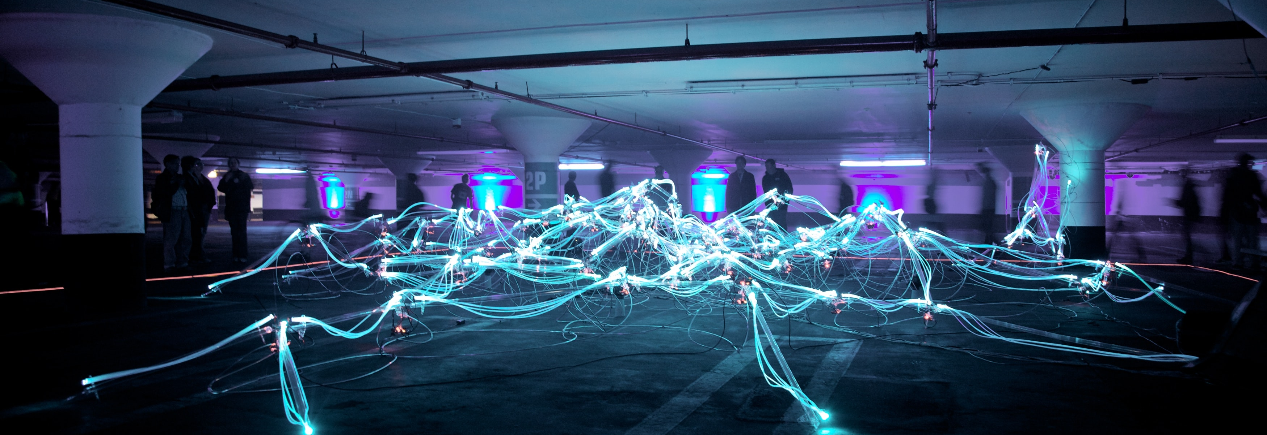
Updating
Photo by Marius Masalar on Unsplash
Notes:
Rob - We are not animals

Slide 8
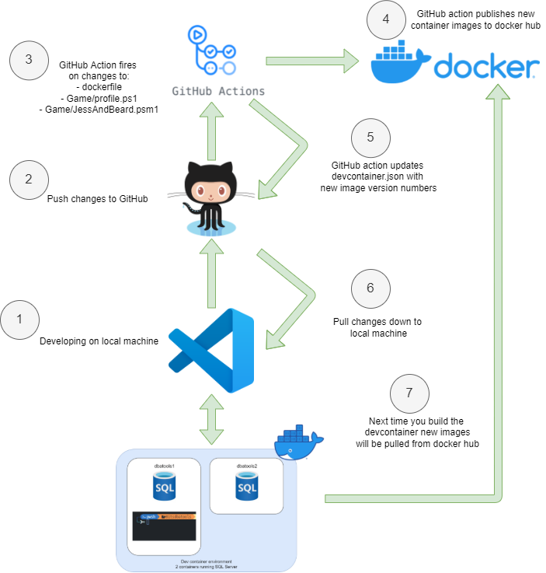
Development Workflow
Notes:
Jess
Docker image tags
Then the devcontainer will notice the configurations changed and when we rebuild it’ll pull new images

Slide 9
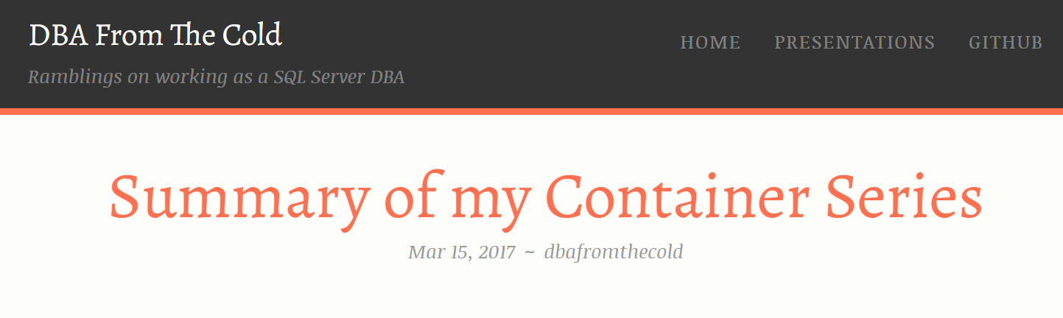
dbafromthecold.com

Slide 10
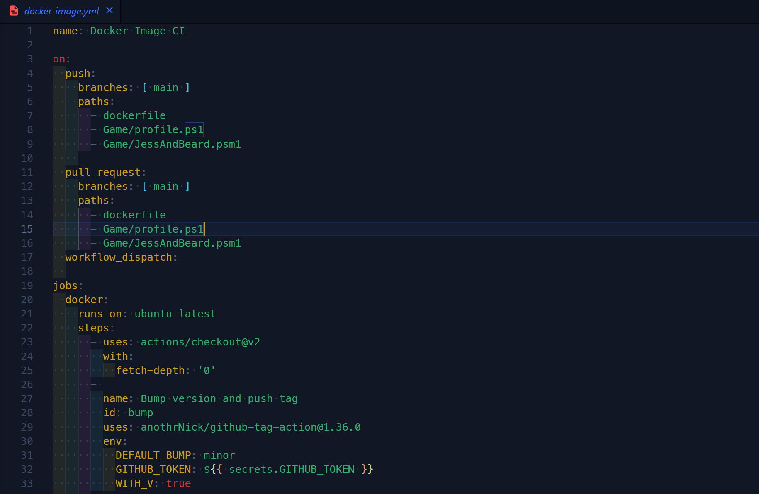
GitHub workflow
Notes:
Jess
On push paths – certain files that meant we wanted to rebuild container
Workflow_dispatch – so we can run it manually
Bump version

Slide 11
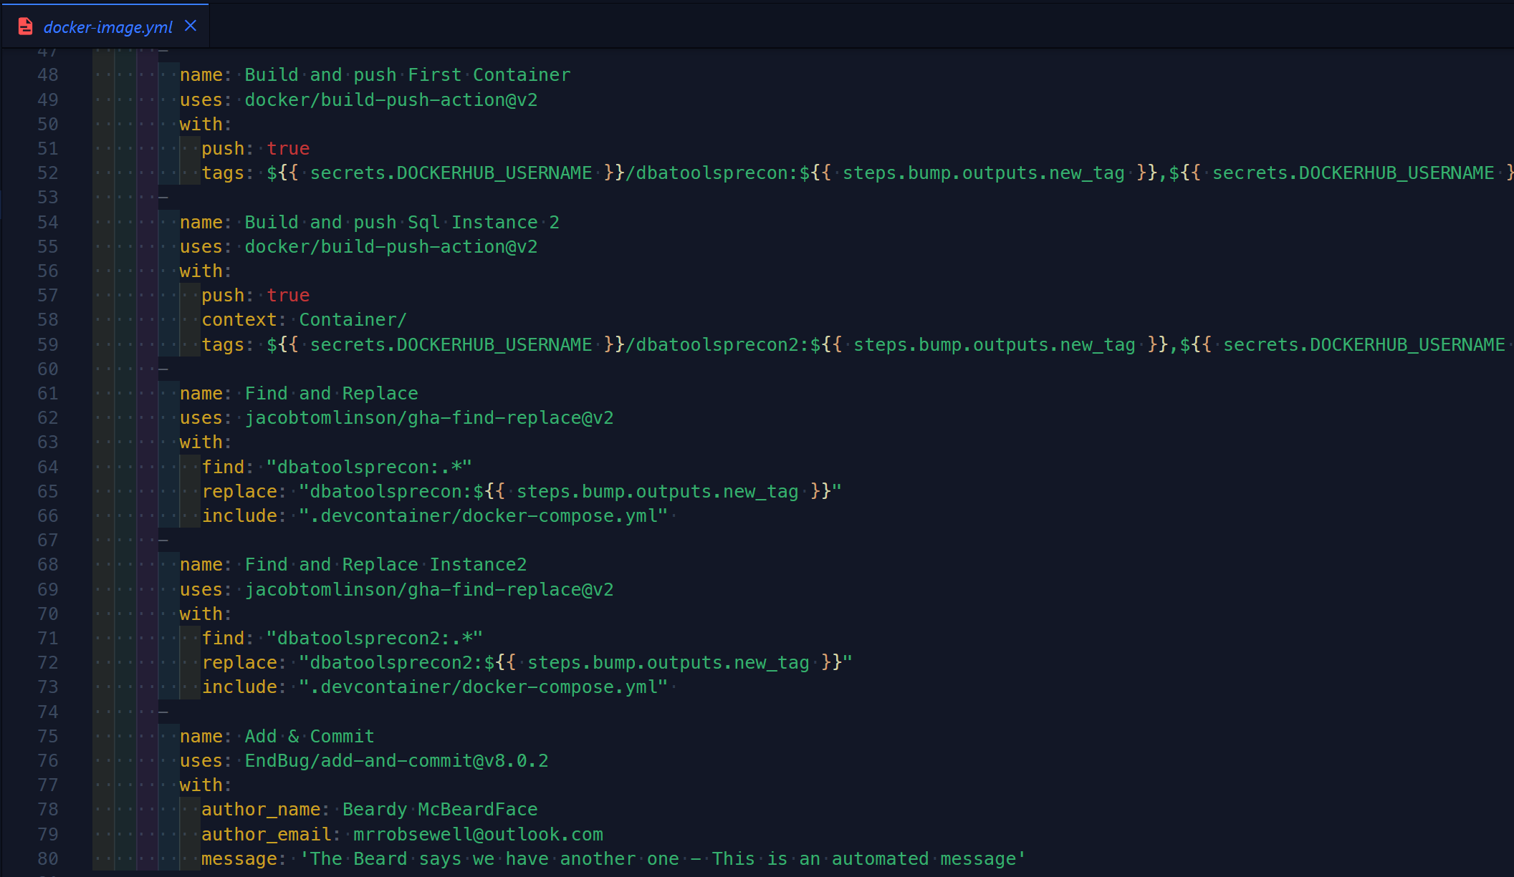
GitHub workflow
Notes:
Jess
Github secrets – following best practices not to store credentials in our repo
Build-push-action – pushes containers to docker repo
Find & replace – 2 steps – couldn’t be bothered with the regex
Add & commit

Slide 12
What is Pester?
Pester provides a framework for running unit tests to execute and validate PowerShell commands from within PowerShell
https://github.com/pester/Pester
Notes:
Its used for unit testing or TDD but can also be used to validate an environment. Comes with Windows 10 or install from the gallery with Install-Module Pester

Slide 13
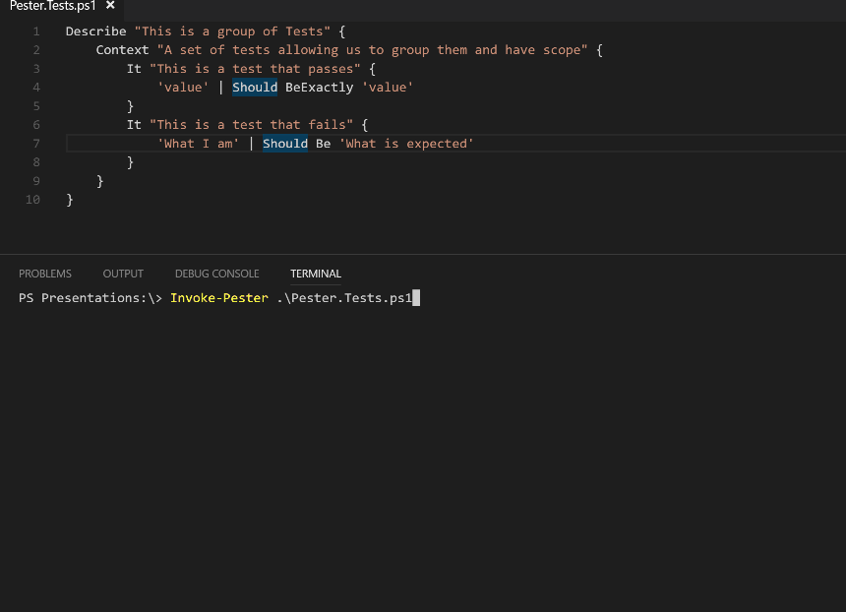
What Does Pester Look Like?
Notes:
This is a Pester test running in VS Code

Slide 14

Hey Beardy!
Time For A DEMO

Slide 16
Rob Sewell
@sqldbawithbeard
blog.robsewell.com
github.com/SQLDbaWithABeard
linkedin.com/in/robsewellsqldba

